Slide 1
Java Server Pages JSP Syntax Techniques: MVC Design Pattern Dynamic DB Connection #JSP #MVC #JavaEE

Slide 2
Review
How to deploy the Web Application to Web Server?
File and Directory Structures (WEB-INF and others → war file)
The Servlet Container, The Servlet Context, The Servlet Config
Parameters
How to transfer from resources to others with/without data/objects?
Attributes
Vs. Parameters, Vs. Variables
Request, Session, and Context Scope (Memory Segment)
Request Dispatcher
forward, include
Vs. response.sendRedirect
Break down structure component in building web application
Some concepts
Filter
Filter, Filter Chain, Filter with Wrapper class
Vs. Request Dispatcher

Slide 3
Objectives
How to build web application applying MVC model using Servlet, JSP + Scripting Element
JSP vs. Servlet
MVC Model
JSP mechanism, syntax
How to use JSP combining the Servlets and Java objects
How to connect DB using Dynamic connection or DataSource

Slide 4
Java Server Pages Need for JSP
Servlet
Is a java class that must be compiled to deploy on server
Low level HTML format that does not focus on the presentation logic (very complex) of the web application
Is not flexible in modify with editor program
→ Need the replaced thing that is easily focus on the presentation logic and approaches the non-experience presentation developer

Slide 5
Java Server Pages JSP
Java Server Page (JSP) is a server side script language running web (application) server (Tomcat, Sun, JBoss …)
Saved with .jsp extension
A simple, yet powerful Java technology for creating and maintaining dynamic-content webs pages (embedded)
JSP page are converted by the web container into a Servlet instance
It focus on the presentation logic of the web application
JSP page contains HTML tags
JSP page contains tags (standard & custom), which are used to generate dynamic content and invoke the operations on Javabeans components and processing requests.
A combination of HTML, XML, Servlet (extends from Servlet), and Java Code to create dynamic Web content.

Slide 6
Java Server Pages (JSP)
Benefits
Segregation of the work profiles of a Web designer and a Web developer (separating presentation logic and content/business/processing logic)
Emphasizing Reusable Components (JavaBeans)
Simplified Page Development (easy to use JSP through tag, flexibility, scalability)
Access & instantiate JavaBeans component (support tag element with get/set functions)
High secure
Choosing Servlet or JSP
Servlet are well suited for handling binary data dynamically
Ex: for uploading files or for creating dynamic images, since they need not contain any display logic
JSP is easy to create the presentation logic with dynamic generated data combine template and do not compile before executing or running time

Slide 7
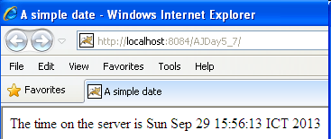
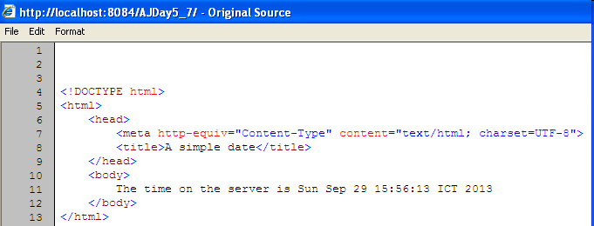
Java Server Pages JSP – Example
Simple JSP page displays current date.
<html>
<head>
<title>A simple date</title>
</head>
<body>
The time on the server is <%= new java.util.Date() %>
</body>
</html>
Server processes JSP components converting static data on HTML which can be displayed by Web browser
To testing JSP page, the JSP page should be copied to the ROOT of web server – Tomcat
View Source

Slide 8

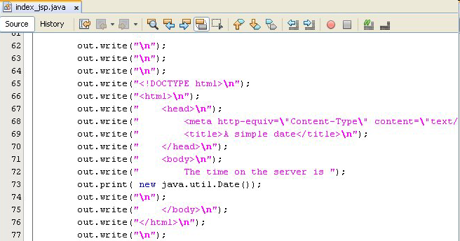
Java Server Pages JSP – In Nature
Applying the compile function on file to check JSP file
public void _jspService(HttpServletRequest request, HttpServletResponse response)
throws java.io.IOException, ServletException {…}

Slide 9
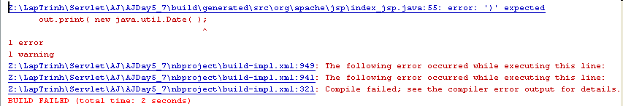
Java Server Pages JSP – In Nature
When the JSP page is requested to server, the JSP page is converted to java file as filename_jsp.java (filename.jsp)
The filename_jsp.java file is complied if it is correct syntax
Ex:
Omit the “)” of Date function in the index_jsp.jsp
Correct above mistake, run the file, then checking the result at
C:\Documents and Settings\LoggedUser\Application Data\NetBeans\ 7.4\apache-tomcat-7.0.41.0_base\work\Catalina\localhost
C:\Users\LoggedUser\AppData\Roaming\NetBeans\7.4\ apache-tomcat-7.0.41.0_base\work\Catalina\localhost

Slide 10
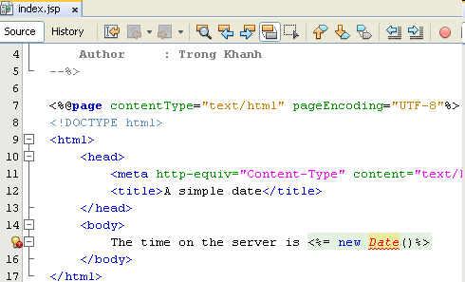
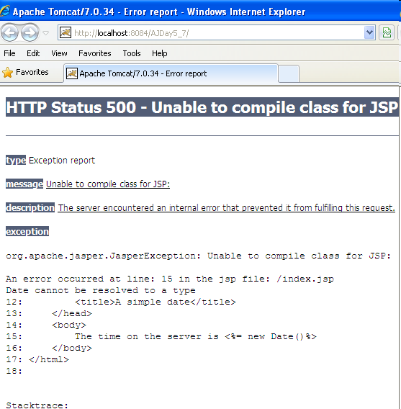
Java Server Pages JSP

Slide 11
JSP Elements JSP Tags
Tags
Interface
Functional
Encapsulation
A tag starts with “<” and ends with “>”.
The tags contain body and attributes.
The 4 types of JSP tags
Comment
Directives
Scripting elements
Standard actions

Slide 12
JSP Elements Comments
Are used for documenting JSP code
Should not be visible to the client
Explains the functioning of the code
Comments are ignored by the servlet during compilation
A JSP page contains 03 types comments as JSP, HTML, and scripting
HTML comments
Are passed to resulting HTML documents
Are not visible in the output but the end user can view them.
JSP comments
The browser cannot view these comments as a part of the source code
Are ignored by the JSP to scriptlet translator.
Scripting language comments
Are written scriptlets in a JSP page.
The comment should be in the same comment syntax used for scripting language.
Are not visible in the output of the JSP page

Slide 13
JSP Elements Comments
Syntax
JSP comments: <%-- comments --%>
Ex: <%-- a JSP comment --%>
HTML comments: <!-- comments -->
Ex: <!-- a HTML comment -->
Scripting language comment
<%/* comments */%>
<%// comments %>
Ex: <%//It’s is a variable declaration %>

Slide 14
JSP Elements Scripting Elements
A way of performing server-side operations in a JSP page
Enable the code to be directly embedded in a JSP page
Insert Java code into the JSP page
Declarations:
Defines the variables and methods for a JSP page
Are inserted into the servlet, outside the _jspservice() method
Are used in combination with scriptlets and expressions to display an output.
A single declaration tag can be used to define multiple variables
Syntax: <%! Declaration; %>
Ex: <%! String s = “FPTU”; %>

Slide 15
JSP Elements Scripting Elements
Scriptlets
Is used to embed Java code, which is inserted into the _jspService() method of the servlet within an HTML code
Refers to code blocks executed for every request (a fragment codes)
Are used to add complex data to an HTML form
Syntax: <% scriptlet %>
Ex: <% for (int i =0 ; i<n; i++){
System.out.println(i + “.This is scriptlets.”); } %>
Expressions
Can be used to display individual variables or the result of some calculation
Contains a Java statement whose value will be evaluated and inserted into the generated web page
Refers to single line codes executed for every request.
Provides dynamic output generation and the result is converted into a string
Evaluates at HTTP request
A declaration block is enclosed between delimiters.
Syntax: <%= expression %>
Ex: <%= i %>

Slide 16
JSP Elements Example 01
Create sample.jsp page
<%@ page import="java.util.Date" %>
<html>
<head>
<title>First JSP program</title>
</head>
<body>
<!-- myFirstProgram.jsp -->
<% out.println("Hello there!"); %><br>
<%= "Current date is " + new Date() %>
<%-- end Program --%>
</body>
</html>
Directives - page
HTML Comments
Scriptlet
Expression
JSP Comments

Slide 17
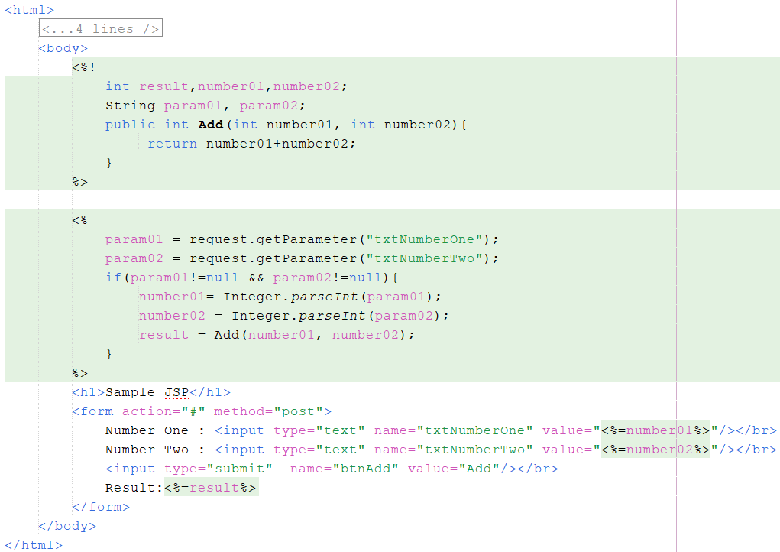
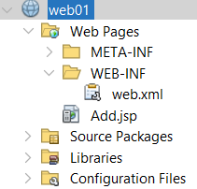
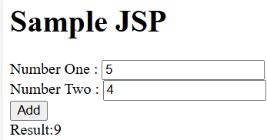
JSP Elements Example 02

Slide 18
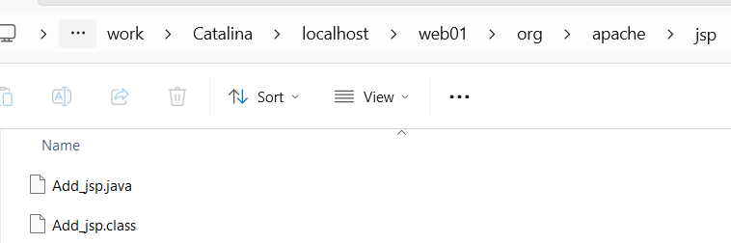
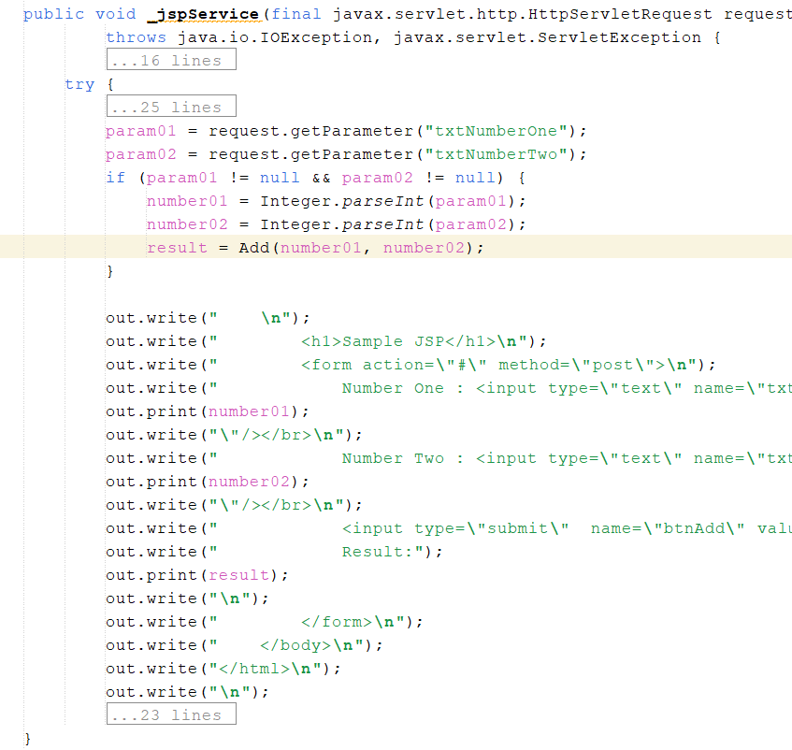
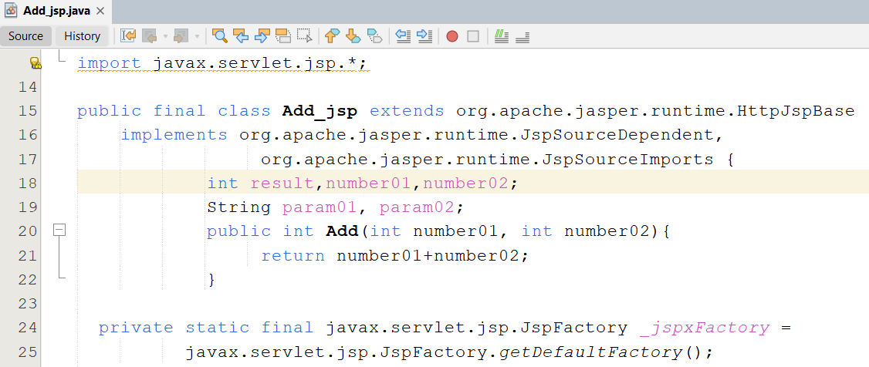
JSP Elements Example 02

Slide 19
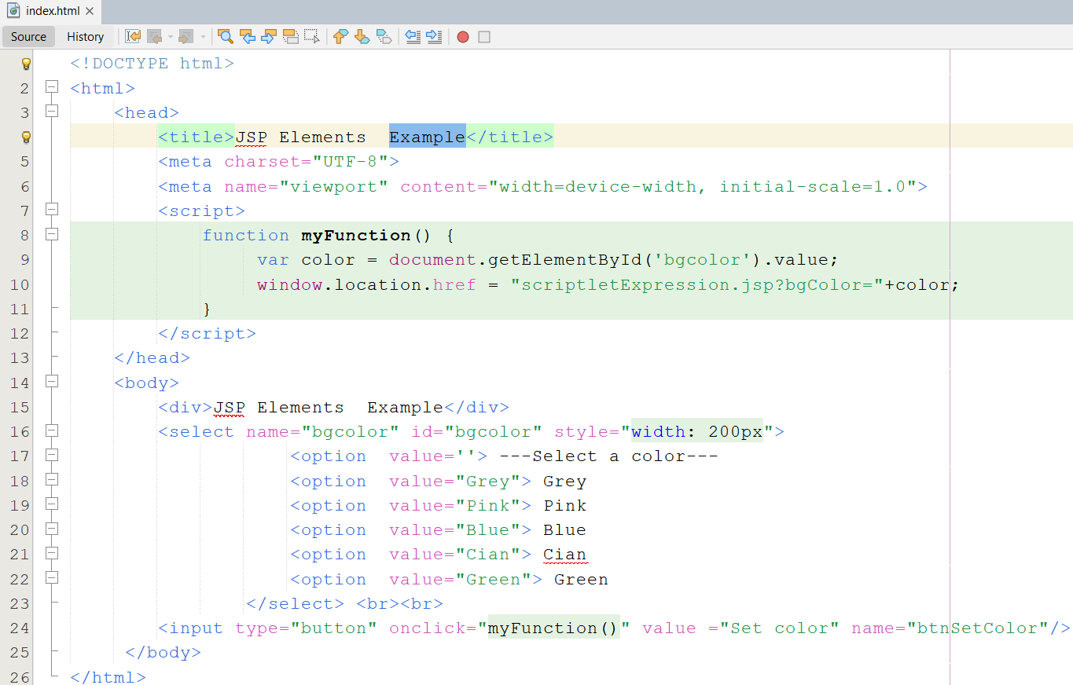
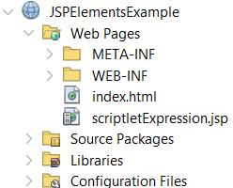
JSP Elements Example 03

Slide 20
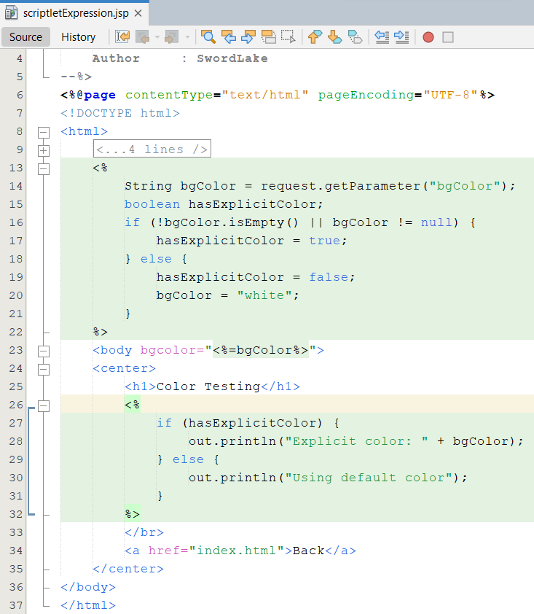
JSP Elements Example 03
Expression!!!

Slide 21
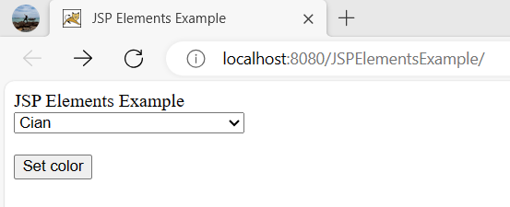
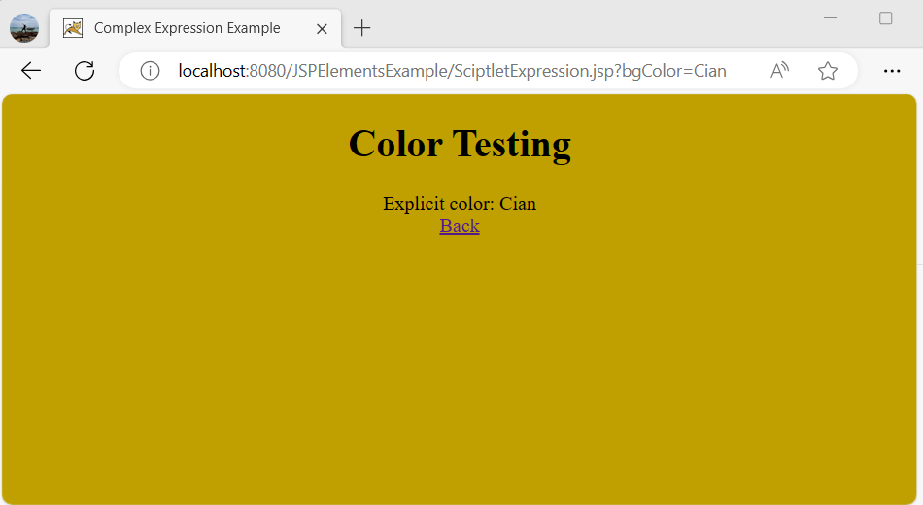
JSP Elements Example 03

Slide 22
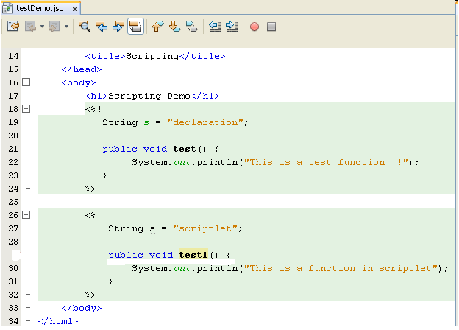
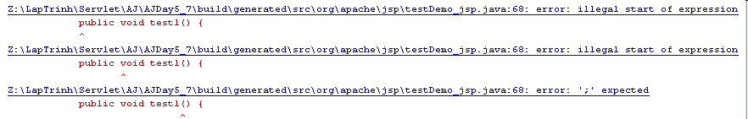
JSP Elements Example – Exception

Slide 23
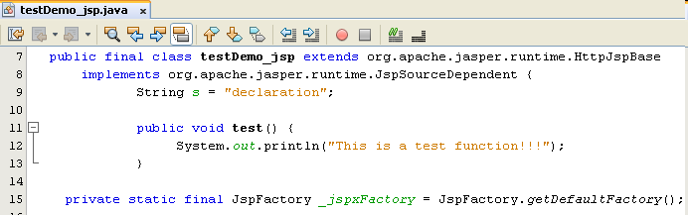
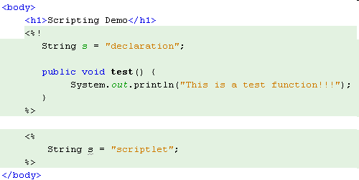
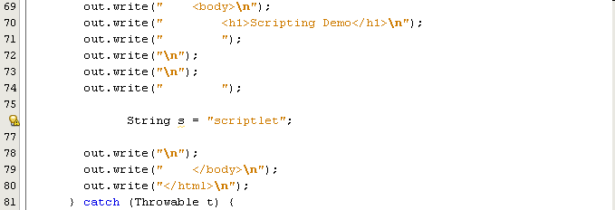
JSP Elements Example – Exception

Slide 24
Java Server Pages JSP Life Cycle
HTTP
WEB
SERVER
JSP
ENGINE
Client
Database
JSPs are processed here
JSP Files

Slide 25
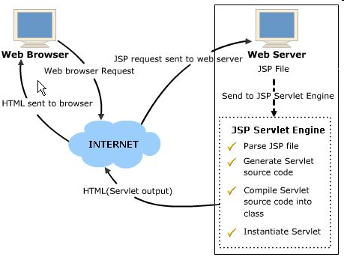
Java Server Pages JSP Life Cycle
1
2
3
6
4
5

Slide 26
Java Server Pages JSP Life Cycle
Servlet from JSP
_jspInit()
Init Event
_jspService()
Request
Response
_jspDestroy()
Destroy Event

Slide 27
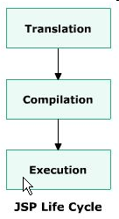
Java Server Pages JSP Life Cycle
Translation
A servlet code to implement JSP tags is automatically generated, complied and loaded into the servlet container.
jspInit() method is invoked when the JSP page is initialized and requested
The _jspService() method corresponds to the body of the JSP page and is defined automatically by the JSP container and never be defined by the JSP page
The jspDestroy() method is invoke when the JSP page is going to be destroyed (requested again)
Notes: the servlet must implement the javax.servlet.jsp.HttpJspPage interface

Slide 28
Java Server Pages JSP Life Cycle
Complication
The JSP page is automatically compiled and executed again by JSP/ Servlet Engine
Execution
Is carried out with the help of page directives controlling various execution parameters and are used for buffering output and handling errors

Slide 29
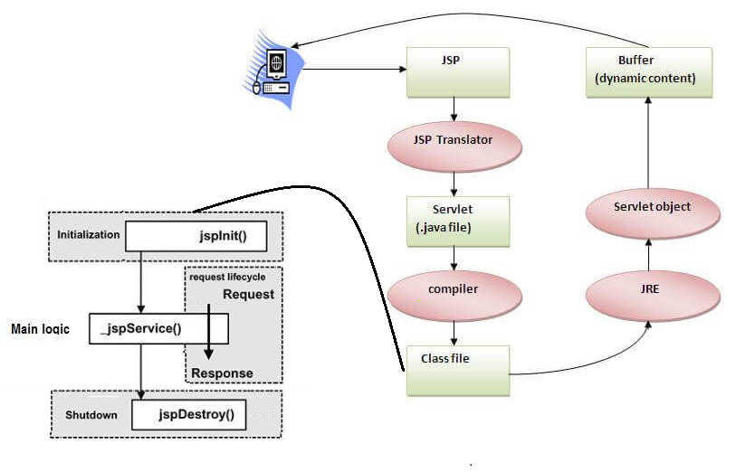
Java Server Pages JSP Life Cycle

Slide 30
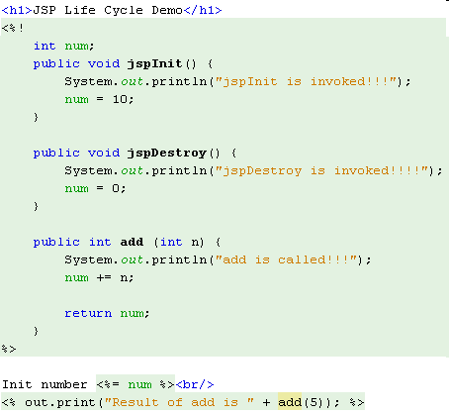
Java Server Pages JSP Life Cycle
jspInit
Declarations
jspDestroy

Slide 31
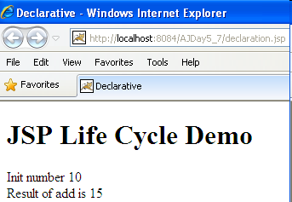

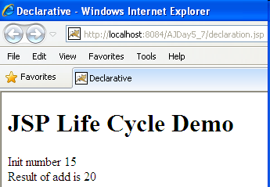
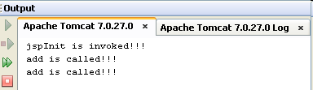
Java Server Pages JSP Life Cycle

Slide 32
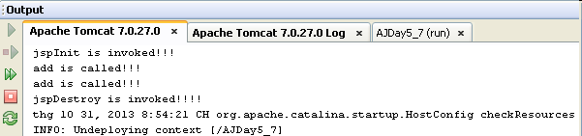
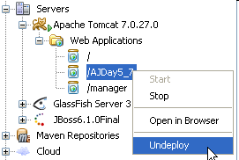
Java Server Pages JSP Life Cycle
Clean and Build Application

Slide 33
JSP Directives Directives
Controls the structure of the servlet by sending messages from the JSP page to the JSP container.
The scope of directives is the entire JSP file
JSP uses directives for controlling the processing of JSP pages.
Do not produce any output and inform the JSP engine about the actions to be performed on the JSP page
Specify scripting language used
Ex: <%@ page language = “java” ...%>
Denote the use of custom tags library (taglib)
Ex: <%@ taglib uri = “c:\...” prefix = “abc” %>
Include the contents of another JSP page into the current page
Ex: <%@ include file = “c:\...” %>
Include Java file to Java packages list.
Ex: <%@ page …. import = “java.util.*, java.lang.*” %>
Error handle in JSP page and JSP page is catched errors (isErrorPage).
Ex: handle error <%@ page … errorpage = “/error.jsp” … %>
process error <%@ page isErrorPage = “true” %>

Slide 34
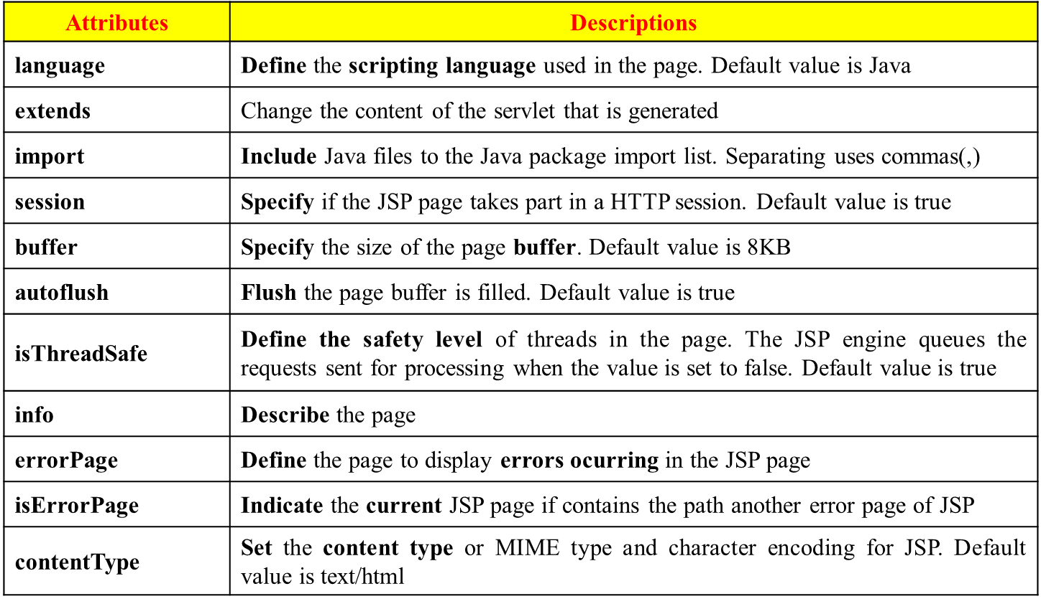
Page Directives
Is used to define and manipulate a number of important attributes that affect the entire JSP page
Is written at the beginning of a JSP page
A JSP page can contain any number of page directives. All directives in the page are processed together during translation and result is applied together to the JSP page
Syntax: <%@ page attributes %>

Slide 35
JSP Directives Include & Taglib Directives
Include
Is used to physically include the contents of another file sending to the server. The included file can be a HTML or JSP
Identify the file through the local URL
A single JSP file can include multiple include directives
Syntax: <%@ include file = “URL” %>
Taglib
Enables the use of custom tags in the JSP page
Access to all the objects that are available for a JSP page
Extend the functionality of a JSP page one after the other
The TLD – Tag Library Descriptor is identified through the URI – Uniform Resource Identifier and prefix describes the prefix string used to define the custom tag
Syntax: <%@ taglib uri = “URL” prefix = “name” %>

Slide 36
JSP Directives Include & Taglib Directives
Main (main.jsp) file
<html>
<head>
<title>Directive Includes JSP program</title>
</head>
<body>
<%-- include use directives --%>
Current date is
<%@ include file = "myDate.jsp" %>
</body>
</html>
Include (myDate.jsp) file
<%@ page import="java.util.Date" %>
<html>
<head>
<title>Date JSP program</title>
</head>
<body>
<%= new Date().toLocaleString() %>
</body>
</html>
main.jsp
JSP Comments
Directives - include
Directives - page
myDate.jsp
Expression

Slide 37
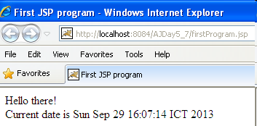
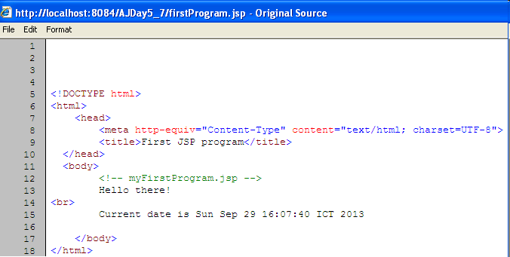
JSP Directives Include & Taglib Directives

Slide 38
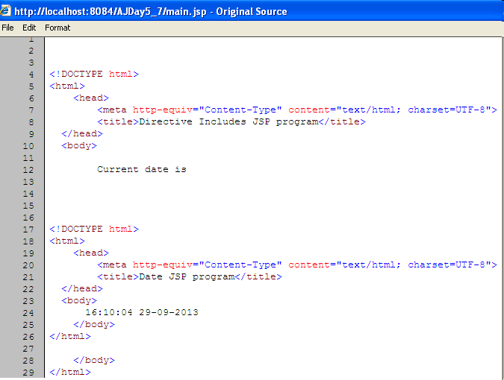

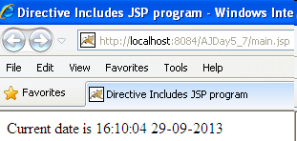
JSP Directives Include & Taglib Directives

Slide 39
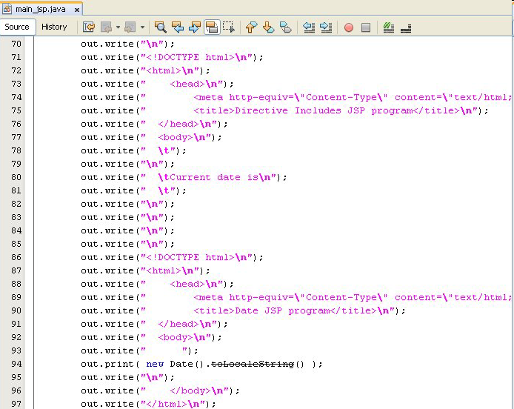
JSP Directives Include & Taglib Directives

Slide 40
JSP Implicit Objects Implicit Objects
Does not initialize or declare
Are loaded by the Web Container automatically and maintains them in a JSP page (Available for scriptlets or expressions)
Created using directives and accessible according to the specified scopes
The names of the implicit objects are reserved words of JSP
The scopes for the implicit objects (IB) in JSP page including page, request, session, and application
Access dynamic content using JavaBeans
Syntax: ImplicitObject.method(params)
Types of Implicit Objects
Input & Output Objects
The objects control page input and output
Are request, response and out
Scope Communication Objects: provide access to all objects available in the given scope
Servlet Objects
Provides information about the page context
Processes request objects from a client and sends the response objects back to the client

Slide 41
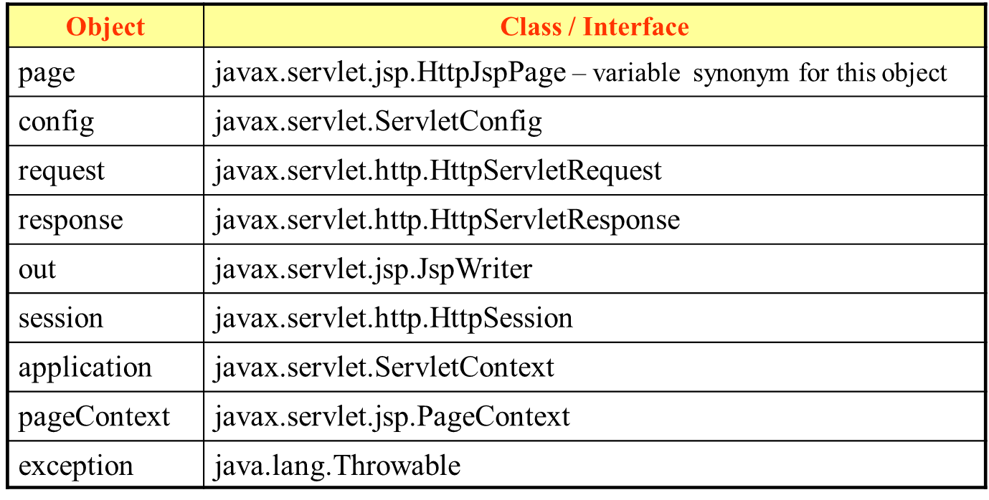
JSP Implicit Objects
Types of Implicit Objects (cont)
The Error Objects
The object handles errors in a JSP page (exception)
Can access this object by declaring your JSP page as an error page <%@page isErrorPage=“true” %>

Slide 42
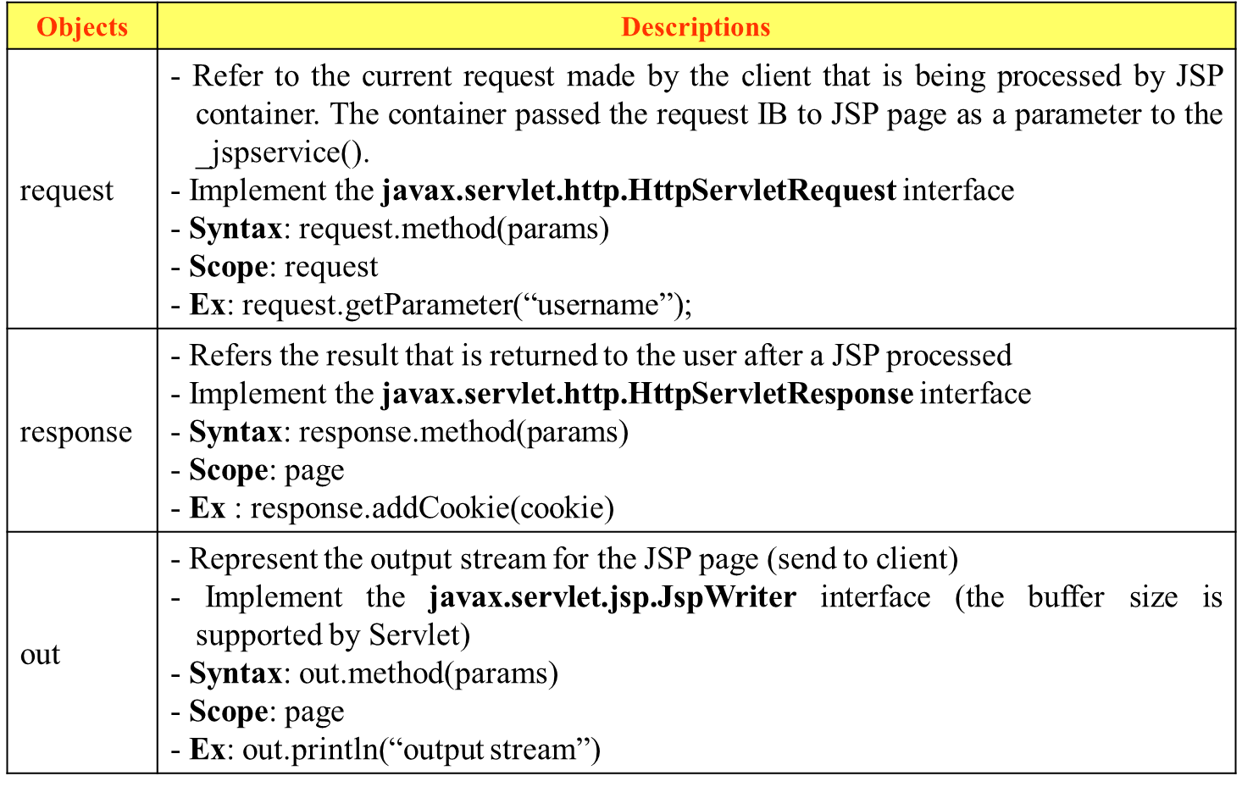
JSP Implicit Objects Input & Output Objects

Slide 43
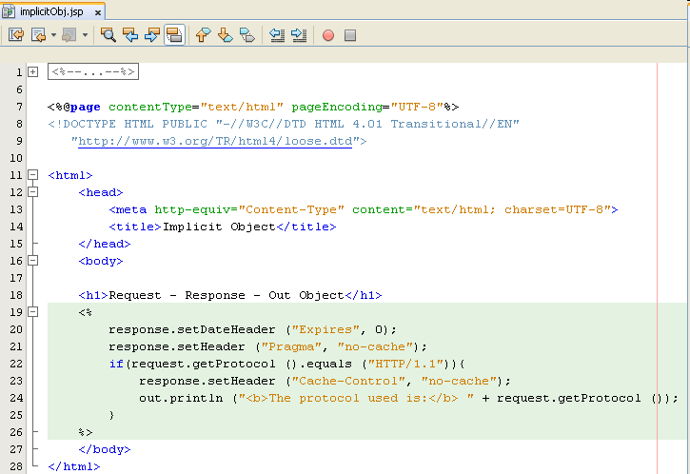
JSP Implicit Objects Input & Output Objects – Example

Slide 44
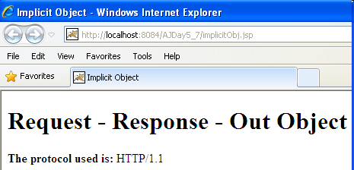
JSP Implicit Objects Input & Output Objects – Example

Slide 45
JSP Implicit Objects Scope Communication Objects
Objects | Descriptions
session | - Specify data and store information in the current session. - Implement the javax.servlet.http.HttpSession interface - Syntax: session.method(params) - Scope: session - Ex: session.setAttribute(“username”, “Tom”);
application | - Represent the application of the required JSP page and represent the servlet context about Web Application in which it is running. - Implement the javax.servlet.ServletContext interface - Syntax: application.method(params) - Scope: application - Ex: application.setAttribute(“username”, “Tom”);
pageContext | - An instance of Pages (javax.jsp.PageContext) Enable access to the JSP page and the attributes associated with that page provides following fields to find the scope or specify the scope of the objects (PAGE, REQUEST, SESSION, and APPLICATION) - Syntax: pageContext.method(params) - Ex: pageContext.getAttributes(“username”);

Slide 46
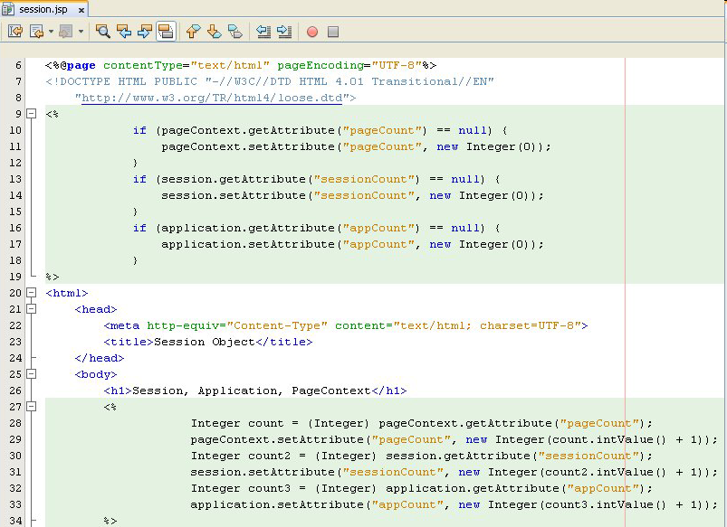
JSP Implicit Objects Scope Communication Objects – Example

Slide 47
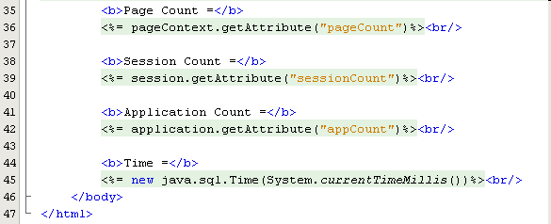
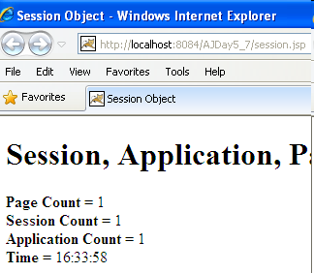
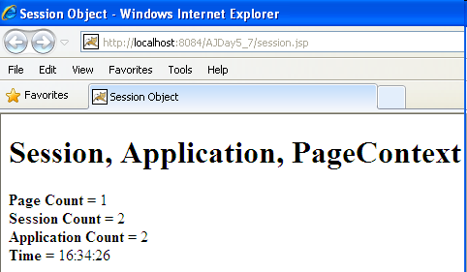
JSP Implicit Objects Scope Communication Objects – Example

Slide 48
JSP Implicit Objects Servlet Objects
Objects | Descriptions
page | - Represents the servlets and the initialization parameters of the servlet are stored in the config IB - Use “this” reference and the page IB represents it. - Implements the javax.lang.object interface - Syntax: <%@ page info = “information” %> - Scope: page
config | - Represent the configuration of the servlet data - Implement the javax.Servlet.ServletConfig interface Access objects through config.getInitParameter(“par”) - Scope: page

Slide 49
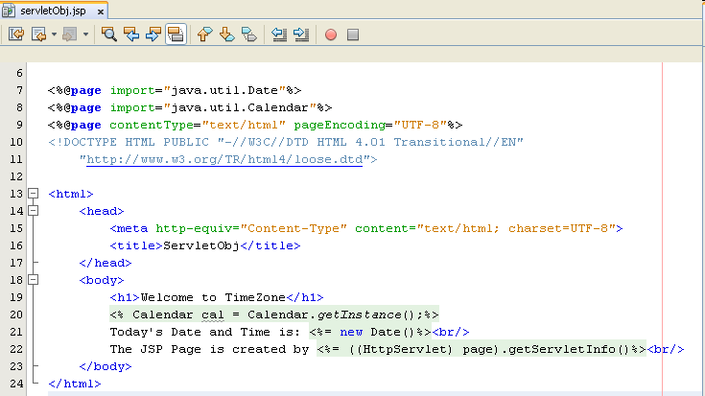
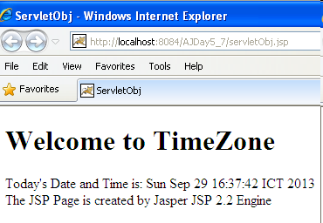
JSP Implicit Objects Servlet Objects – Example

Slide 50
JSP Implicit Objects Error Objects
Objects | Descriptions
exception | - Refer to the runtime exception in an error page - Is available only on pages that are assigned as error page using the isErrorPage attribute of the page directive. - Implement the javax.lang.Throwable interface - Exception methods are supported + getMessage() : return the error message associated with the exception + toString() : Return a string with the class name of the exception within the error message. + printStackTrace(): prints the execution stack in effect when the exception was thrown to the designated output stream

Slide 51
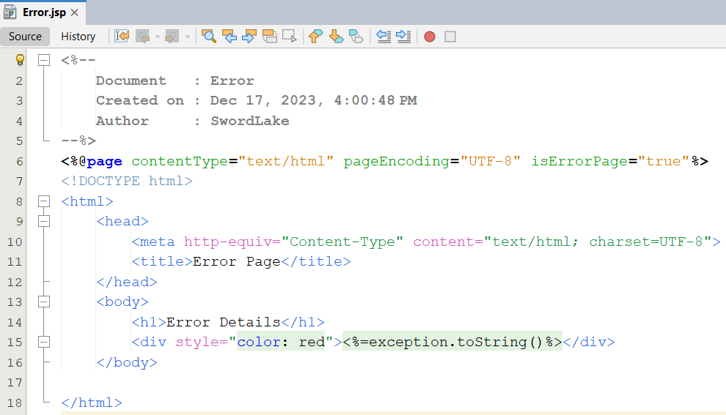
JSP Implicit Objects Error Objects – Example

Slide 52
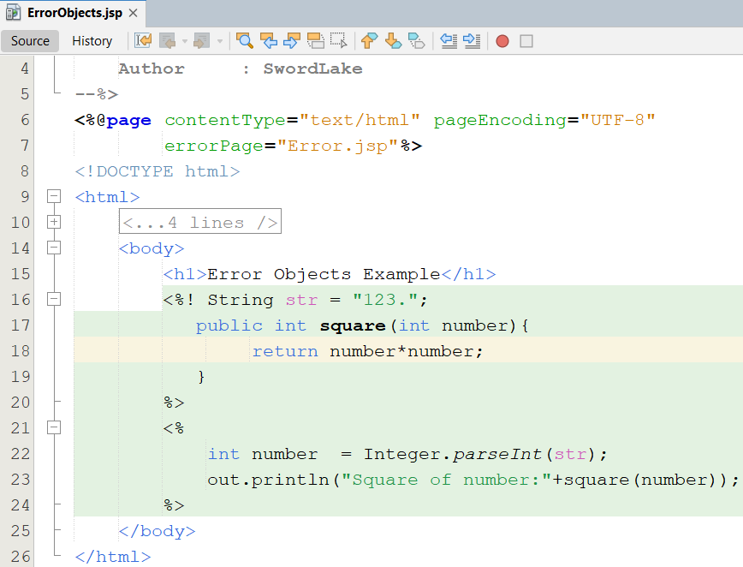
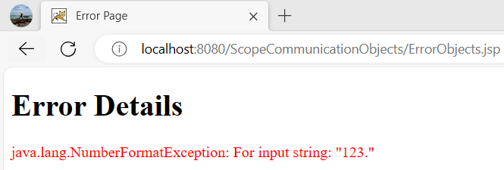
JSP Implicit Objects Error Objects – Example

Slide 53
JSP Elements Overview
Enables to create dynamic JSP pages
The JSP server translates and executes JSP elements
Elements | Description
Root | Classifies standard elements and attributes of namespaces in tag library
Comment | Used in JSP file documentation
Declaration | Declares variables and methods in a scripting language page.
Expression | Includes expression in a scripting language page
Scriptlet | Includes code fragment in a scripting language page
Text | Includes data and text
include Directive | Includes content of one JSP page into the current JSP page

Slide 54

JSP Elements Overview

Slide 55




MVC Design Pattern MVC Model

Slide 56




MVC Design Pattern Model – View – Controller
Sees
User
Uses
Updates
Manipulates
View
Controller
Model
This is a MVC Model

Slide 57

MVC Design Pattern Model – View – Controller
www.netbeans.org

Slide 58

MVC Design Pattern Model – View – Controller
www.netbeans.org

Slide 59










MVC Design Pattern MVC Model 2
Container

Slide 60
MVC Design Pattern MVC Model 2
Separates the “Business Logic” from the “Presentation Logic” and has an additional component – a Controller
Use Servlet and JSP together
JSP pages
Are used only for presentation
Retrieve the objects created by the Servlet
Extract dynamic content for insertion within a template for display
Servlet
Handles initial request, partially process the data, set up beans, select suitable business logic to handle request , then forward the results to one of a number of different JSP pages
Serves as a gatekeeper provides common services, such as authentication authorization, login, error handling, and etc
Servlet serves as a central controller that act as a state machine or an event dispatcher to decide upon the appropriate logic to handle the request
Act as a Controller that controls the way Model and View layer interacts

Slide 61
MVC Design Pattern MVC Model 2 – Generalization
Servlet-centric Scenario

Slide 62



MVC Design Pattern MVC Model 2 – Generalization
1
View
Controller
Model
2

Slide 63

MVC Design Pattern MVC Model 2 – Generalization
3

Slide 64



MVC Design Pattern MVC Model 2 – Generalization
4
5
6

Slide 65




MVC Design Pattern MVC Model 2 – Generalization
7
8

Slide 66
MVC Design Pattern MVC Model 2 – Generalization
Purpose
Separation of presentation logic and business logic
A Model represents information specific to a particular domain on which the application operates
A View is typically a user interface element. A single Model may be presented as multiple views
A Controller component responds to events and processes request and may invoked changes on the Model
Advantages
Easier to build, maintain and extend
Provide single point of control (Servlet) for security & logging
Encapsulate incoming data into a form usable by the backend
Can reusable code
Limitations
Increase Design Complexity

Slide 67
Summary
How to build web application applying MVC model using Servlet, JSP + Scripting Element
JSP vs. Servlet
JSP mechanism, syntax
MVC Model
How to use JSP combining the Servlets and Java objects
How to connect DB using Dynamic connection or DataSource
Q&A

Slide 68
Practice
Do Lab04_ManageUsersByMVC2.pdf

Slide 69



How to write CRUD Web App Update/Delete Function

Slide 70
Appendix – MVC Design Pattern Model – View – Controller
Main concern of MVC is to separate the data (model) and the user interface (view)
Helps the developer changing to the user interface can be made without affecting the underlying data handling logic.
The data can be reorganized without changing the user interface.
Separation is achieved by introducing an controller component
Controller is an intermediate component
Controller defines as how the user interface should react to a user input

Slide 71
Appendix – MVC Design Pattern Model – View – Controller
Model
Contains only the pure application data (it contains no logic describing how to present the data to a user)
Models data and behavior behind business process
Manages information (access, modify, and represent application’s data) and notifies observers whenever the information changes
Maps Real-World Entities (implement business logic, workflow)
Performing DB Queries
Calculating Business Process
Encapsulates Domain Logic (a Java Object – Java Bean) which are independent of Presentation
View
Obtains data from model & presents the model's data to the user
Represents Output/Input of the application (GUI – JSP & HTML …)
Display results of Business Logic
Free Access to Model, but should not change the state of the model.
Reads Data from Model – Using Query Methods

Slide 72
Appendix – MVC Design Pattern Model – View – Controller
Controller
Serves logical connection between user’s interaction and the business process
It receives and translates input to request on model or view
Input from user and instructs the model and view to perform action
Responsible for making decision among multiple presentation
Maps the end-user action to the application response
Is responsible for calling methods on the model that changes the state of the model
Updates the state of the Model and generates one or more views (servlets)
Evolution of MVC Architecture
NO MVC
MVC Model 1 [Page-centric] – JSP Model 1
MVC Model 2 [Servlet-centric] – JSP Model 2

Slide 73
Appendix – MVC Design Pattern Model – View – Controller
Relationships between components
View and Controller: Controller is responsible for creating or selecting view
Model and View
View depends on Model
If a change is made to the model then there might be required to make parallel changes in the view
Model and Controller
Controller depends on model
If a change is made to the model then there might be required to make parallel changes in the Controller
Logical Layers in Web application
Model [Business Process Layer]
View [Presentation Layer]
Controller [Control Layer]

Slide 74
Appendix – MVC Design Pattern MVC Model 1
Composed of a series of interrelated JSP pages
JSP page handles the entire request processing mechanism
Extract the HTTP request parameters
Invoke the business logic (through Java Beans)
Process the business logic
Handle the HTTP session
JSP page responsible for displaying the output to the client
There is no extra Servlet involved in the process.
A page centric architecture (Business process logic and control decisions are hard coded inside JSP pages)
Next page selection is determined by hyperlink or action of submitting a form. Ex:
<a href=“find.jsp”> Search </a>
<form action=“find.jsp”> … </form>

Slide 75
Appendix Data Source
Java EE applications use DataSource objects when they access relational databases through the JDBC API
A DataSource object works with a JNDI naming service
After it is registered with a JNDI naming service, an application can use the JNDI API to access that DataSource object
A DataSource has a set of properties that identify and describe the real-world data source that it represents
A DataSource XML descriptor that contains essential information, such as the name of the underlying JDBC driver, database URL, the name of the database, and the network protocol, connection pooling properties, and so on
A DataSource alias is a logical name mapped to the name of a real DataSource available in the system. It specified in the name element begins with a namespace scope
java:comp/env/, the datasource will be available for the component in which it is defined, such as a servlet, EJB, or application client component
The DataSource alias is used in application code to connect to the underlying data source

Slide 76




Appendix Dynamic DB Connection
Adding and modify the web.xml as following

Slide 77

Appendix Dynamic DB Connection
Adding and modify the web.xml as following

Slide 78


Appendix Dynamic DB Connection
Adding and modify the context.xml in the META-INF directory as following
Implement code to use

